Slide 1
Read an image

Slide 2
Steps
1- Read images as gray scale
2- Reshape and Convert to array
3- Visualize an image
4- Split the data
5- Scale the data
6-Train the model
7- Predict and Evaluate

Slide 3
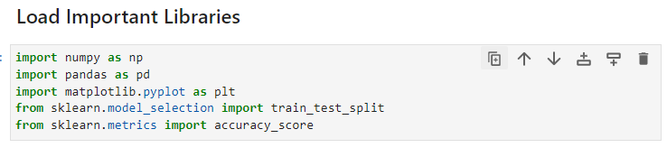
Libraries
Scikit-learn is a library in Python that provides many unsupervised and supervised learning algorithms. It’s built upon some of the technology you might already be familiar with, like NumPy, pandas, and Matplotlib!
NumPy is a Python library used for working with arrays.
It also has functions for working in domain of linear algebra, fourier transform, and matrices.
Pandas is a Python library used for working with data sets.
It has functions for analyzing, cleaning, exploring, and manipulating data.
Matplotlib is a low level graph plotting library in python that serves as a visualization utility.

Slide 4
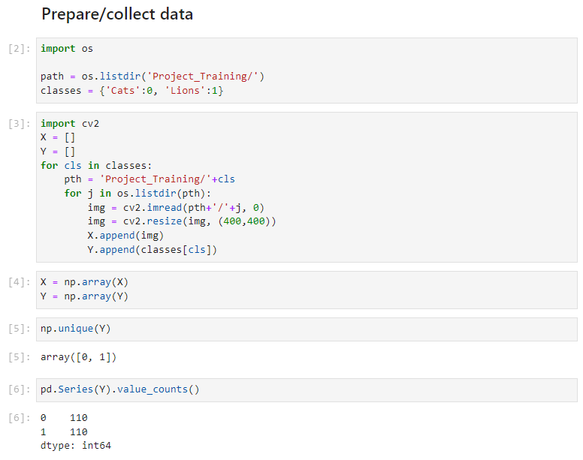
2- Collect data
4-then we want to reshape the size of the image to make them all with the same size then define two list one to save the image and the other to save if this image with cat or lion. Then we convert x ,y to array to make it easy to handle them.
1-os.listdir() method in python is used to get the list of all files and directories in the specified directory. If we don’t specify any directory, then list of files and directories in the current working directory will be returned.
3-We will see that we have two files in the project training folder one for the cats and folder with images for lions first we enter every folder and read the image using imread function that takes the path of the image and its name and 0 parameter means that we want to read the image in gray scale
2- After we specify the location we want ,we define a dictionary 0 for the cats and 1 for the lions.
We want to know how many image we have with cats and how many image we have for lions. So first we convert it to series to use the function value counts.

Slide 5
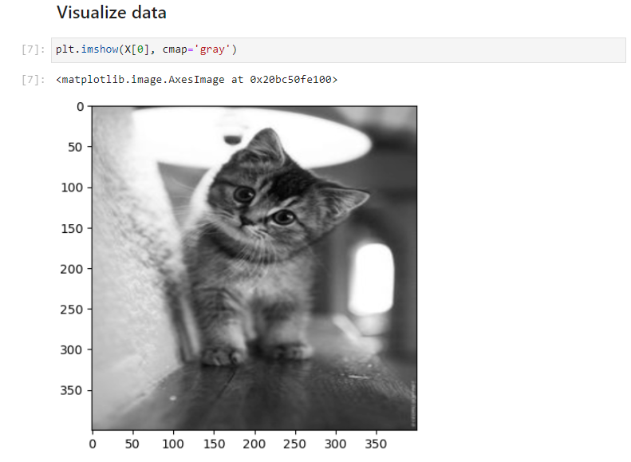
3- Visualize data
We want to visualize or print one of the image we have save in x , using imshow method is used to display an image in a window. The window automatically fits the image size.​
We give it the image we want to print so let’s say the first image and determine the color map that we want it to be also in gray scale.​
​

Slide 6
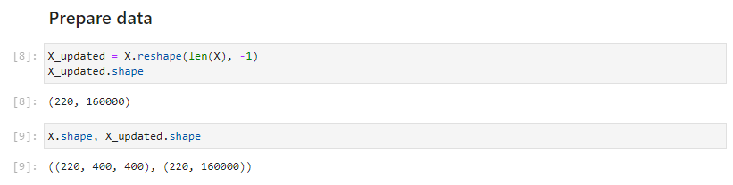
4- Prepare data
We reshape the size of the imege to merge the two dimension into one to make the image one dimension.

Slide 7
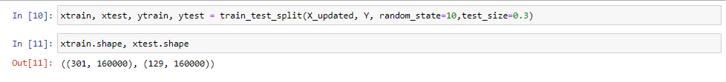
5- Split Data
Then we split the data to train and test as always . ​

Slide 8
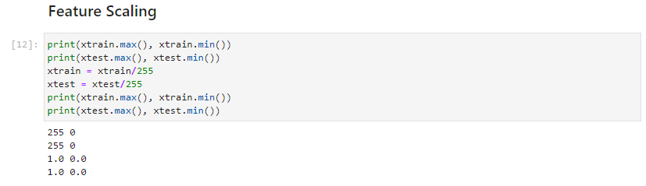
6- Feature Scaling
To reduce our range to make it between 0 and 1 we will divide the values on the largest value and we all know that our range of colors is between 0 and 255 so the biggest value is 255 .all of this to rescale our value between 0 and 1.​
​

Slide 9
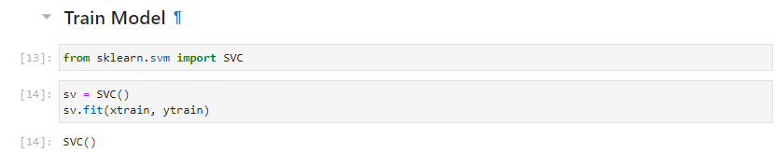
7- Train Model
We import svm for classification which is called SVC .​
And give it x train and y train to train how to sperate between cats and lions.​

Slide 10
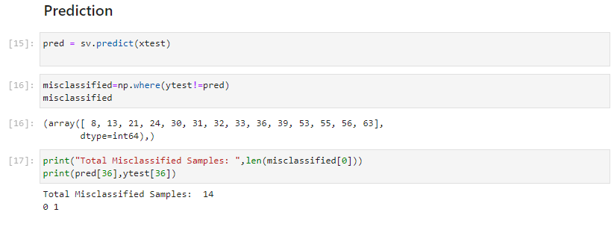
8- Prediction
Now we want to test the accuracy of our model so now we will give the model new data that he have not seen before which will be our test data and from the line of svm it suppose to give us the y or the label. Then we define a variable to store the cases that the model classified it wrong .

Slide 11
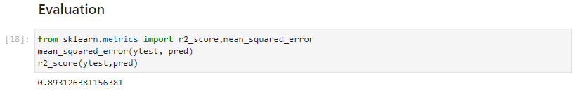
9- Evaluation
Two functions to evaluate performance ​ 1- mean square error :the average squared difference between the estimated values and true value.​ 2- r2_score : R2 (coefficient of determination) regression score function.​ Finally we will give it the true value which will be our test data and the predicted value from our model .​ ​

Slide 12
Our code in github
Click here

Slide 13
Thank You

